Slide 1
THE LOGIC OF QUANTUFIED STATEMENTS
SESSION 5-6
Course : Z0184- Discrete Mathematics
Effective Period: September 2017

Slide 2
These slides have been adapted from :
Susanna S.Epp. (2010). Discrete Mathematics with Applications.4th edition. Thomson Brooks/Cole. USA. ISBN: 9780534359454
Chapter 3
Acknowledgement

Slide 3
On successful completion of this Course, students will be able to:
Learning Objectives
LO 1: Explain the logic of compound and quantified statements and how do to proof
LO 2: Explain and applying Set Theory, Counting method and Number Theory
LO 3: Explain Function, recursion, fuzzy set, Relations and Graph Theory
LO 4: Explain Trees & Graph theory and its application
LO 5: Explain Automata and graph its application in computer science

Slide 4
Predicates and Quantified Statements
. . . it was not till within the last few years that it has been realized how fundamental any and some are to the very nature of mathematics.
— A. N. Whitehead (1861–1947)

Slide 5
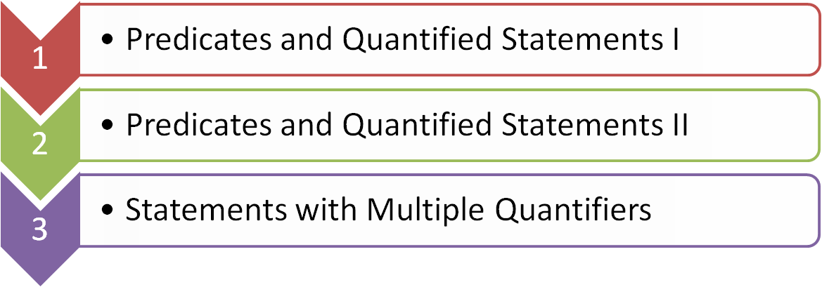
Outline

Slide 6
PREDICATES AND QUANTIFIED STATEMENTS I

Slide 7
Statements
Definition
A statement (or proposition) is a sentence that is true or false but not both.
Propositions | Not Propositions
3 + 2 = 32 | Bring me coffee!
5 – 2 = 3 | x + y > 0
Every cow has 4 legs. | 3 + 2
There is other life in the universe. | Do you like Cake?

Slide 8






Predicates
Definition
A predicate is a sentence that contains a finite number of variables and becomes a propositions when specific values are substituted for the variables.
Example:
Suppose Q(x,y) = “x > y”
Statement (Proposition), YES or NO?
Q(x,y)
Q(3,4)
Q(x,9)
Predicate, YES or NO?
Q(x,y)
Q(3,4)
Q(x,9)

Slide 9
Finding Truth Values
of a Predicate
Let P(x) be the predicate "x² > x" with domain the set R of all real numbers. Wrif dxte P(2), P(1/2), P(-2), and indicate which of these propositions are true and which are false!
P(2) : 2² > 2 or 4 > 2. TRUE
P(1/2) : (1/2) ² > (1/2) or (1/4) > (1/2). FALSE
P(-2) : (-2)² > 2 or 4 > 2. TRUE

Slide 10
The Truth Set of The Predicate
Definition :
If P(x) is a predicate and x has domain D, the truth set of P(x) is the set of all elements of D that make P(x) true when they are substituted for x. The truth set of P(x) is denoted {x ∈ D | P(x)}.

Slide 11
The Truth Set of The Predicate
Let Q(n) be the predicate “n is a factor of 8.” Find the truth set of Q(n) if
a. the domain of n is the set Z+ of all positive integers
b. the domain of n is the set Z of all integers.
Solution :
a. The truth set is {1, 2, 4, 8} because these are exactly the positive integers that divide 8 evenly.
b. The truth set is {1, 2, 4, 8,−1,−2,−4,−8} because the negative integers−1,−2,−4, and −8 also divide into 8 without leaving a remainder. ■

Slide 12
Change Predicates
Into Propositions
One sure way to change predicates into propositions is to assign specific values to all their variables.
Example :
If x represents the number 35, the sentence "x is (evenly) divisible by 5" is a true propositions since 35 = 5٠7.
The way to obtain propositions from predicates is to add quantifiers.
Quantifiers are words that refer to quantities such as "some" or "all" and tell for how many elements a given predicate is true.

Slide 13
The Universal Quantifier, ∀
The symbol ∀ denotes "for all" and is called the universal quantifier.
Example :
The sentence "All human beings are mortal" is to write
∀ human beings x, x is mortal
or, more formally
∀x ∈ S, x is mortal,
where S denotes the set of all human beings.

Slide 14
Truth and Falsity of
Universal Proposition
Let Q(x) be a predicate and D the domain of x. A universal proposition is a proposition of the form
"∀x ∈ D, Q(x)“.
It is defined to be true if, and only if, Q(x) is true for every x in D.
It is defined to be false if, and only if, Q(x) is false for at least one x in D.
A value for x for which Q (x) is false is called a counter example to the universal proposition.

Slide 15
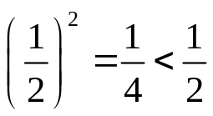
Example: Truth and
Falsity of Universal Proposition
Let D = {1, 2, 3,4, 5}, and consider the proposition “∀x ∈ D, x² ≥ x”
Show that this proposition is true.
Solution:
Check that "x² ≥ x" is true for each individual x in D. 1² > 1, 2² > 2,
3² > 3, 4² > 4, 5² > 5. Hence " ∀x ∈ D,x² ≥ x " is true.
b. Consider the proposition ∀x ∈ R, x² ≥ x. Find a counter example to
show that this proposition is false.
Solution:
Counter example: Take x = 1/2. Then x is in R (since 1/2 is a real number) and
hence "∀x ∈ R, x² ≥ x " is false.

Slide 16
The Existential Quantifier, ∃
The symbol ∃ denotes "there exists" and is called the existential quantifier.
Example:
The sentence "There is a student in Math 140" can be written as
∃ a person s such that s is a student in Math 140,
or more formally,
∃ s ∈ S such that s is a student in Math 140,
where S is the set of all people.

Slide 17
Truth and Falsity of Existential
Proposition
Let Q(x) be a predicate and D the domain of x. An existential proposition is a proposition of the form "∃ x ∈ D such that Q(x)“.
It is defined to be true if, and only if, Q(x) is true for at least one x in D.
It is defined to be false if, and only if, Q(x) is false for all x in D.

Slide 18
Example: Truth and Falsity
of Existential Proposition
Consider the proposition “∃ m ∈ Z such that m² = m”.
Show that this proposition is true.
Solution:
Observe that 1² = 1. Thus"m² = m" is true for at least one integer m. Hence “∃ m ∈ Z such that m² = m” is true.
Let E = {5, 6, 7, 8, 9} and consider the statement “∃ m ∈ Z such that m² = m”. Show that this proposition is false.
Solution:
Note that m² = m is not true for any integers m from 5 to 9: 5² = 25 ≠ 5, 6² = 36 ≠ 6, 7² = 49 ≠ 7, 8² = 64 ≠ 8, 9² = 81 ≠ 9. Thus “∃ m ∈ Z such that m² = m” is false.

Slide 19
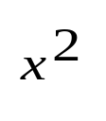
Universal Conditional
Propositions
A reasonable argument can be made that the most important form of proposition in mathematics is the universal conditional proposition:
∀x, if P(x) then Q(x),
or
∀x, P(x) → Q(x).
Example :
∀x ∈ R, if x > 2 then > 4.
(If a real number is greater than 2 then its square is greater than 4.)

Slide 20
PREDICATES AND QUANTIFIED STATEMENTS II

Slide 21
Negation of an Universal
Proposition
The negation of a proposition of the form
∀ x in D, Q(x)
is logically equivalent to a proposition of the form
∃ x in D such that ~Q(x).
Symbolically,
~(x ∈ D, Q(x)) ≡ ∃ x ∈ D such that ~Q(x).
Example:
A formal negations for the proposition “∀ primes p, p is odd” is “∃ a prime p such that p is not odd”.

Slide 22
Negation of an Existential
Proposition
The negation of a proposition of the form
∃x in D such that Q(x)
is logically equivalent to a proposition of the form
∀x in D,~Q(x).
Symbolically,
~(∃x in D such that Q(x)) ≡ ∀x in D,~Q(x).
Example:
A formal negations for the proposition “∃ a triangle T such that the sum of the angles of T equals 200°” is “∀ triangles T, the sum of the angles of T does not equal 200°. ”.

Slide 23
Negations of Universal Conditional Statements
Negation of a Universal Conditional Statement
∼(∀x, if P(x) then Q(x)) ≡ ∃x such that P(x) and ∼Q(x).
Example :
a. ∀ people p, if p is blond then p has blue eyes.
b. If a computer program has more than 100,000 lines, then it contains a bug.
Solution
a. ∃ a person p such that p is blond and p does not have blue eyes.
b. There is at least one computer program that has more than 100,000 lines and does notcontain a bug. ■

Slide 24
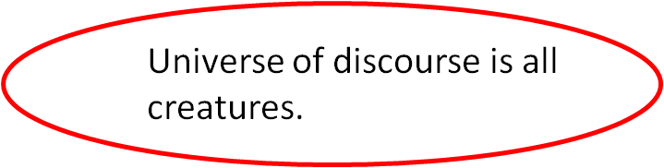
More Example
B(x) = “x is a hummingbird.”
L(x) = “x is a large bird.”
H(x) = “x lives on honey.”
R(x) = “x is richly colored.”
All hummingbirds are richly colored:
∀x (B(x) →R(x))
No large birds live on honey: ¬∃x (L(x) ∧ H(x))
Birds that do not live on honey are dully colored:
∀x (¬H(x) → ¬R(x))

Slide 25
STATEMENTS WITH MULTIPLE QUANTIFIERS

Slide 26
Multiple Quantifier
∀ x ∀ y P(x,y)
P(x,y) true for all x, y pairs
∃ x ∃ y P(x,y)
P(x,y) true for at least one x, y pair
∀ x ∃ y P(x,y)
For every value of x we can find a (possibly different) y so that P(x,y) is true.
∃ x ∀ y P(x,y)
There is at least one x for which P(x,y) is always true.

Slide 27
Example: Multiple
Quantifier
Consider the proposition P(x,y) = “x > y”
∀x P(x,y) is not a proposition
∀x∀y P(x,y) is false proposition
∀x∃y P(x,y) is true proposition
∀x P(x,3) is false proposition

Slide 28
Interpreting Multiply Quantified Statements
Example :
A college cafeteria line has four stations: salads, main courses, desserts, and beverages. The salad station offers a choice of green salad or fruit salad; the main course station offers spaghetti or fish; the dessert station offers pie or cake; and the beverage station offers milk, soda, or coffee. Three students, Uta, Tim, and Yuen, go through the line and make the following choices:
Uta: green salad, spaghetti, pie, milk
Tim: fruit salad, fish, pie, cake, milk, coffee
Yuen: spaghetti, fish, pie, soda

Slide 29
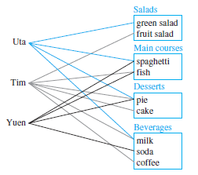
Interpreting Multiply Quantified Statements
These choices are illustrated in this figure :

Slide 30
Example : Interpreting Multiply
Quantified Statements
Write each of following statements informally and find its truth value :
a. ∃ an item I such that ∀ students S, S chose I .
b. ∃ a student S such that ∀ items I, S chose I .
c. ∃ a student S such that ∀ stations Z, ∃ an item I in Z such that S chose I .
d. ∀ students S and ∀ stations Z, ∃ an item I in Z such that S chose I .

Slide 31
Interpreting Multiply Quantified Statements
Solution :
a. There is an item that was chosen by every student. This is true; every student chose pie.
b. There is a student who chose every available item. This is false; no student chose all nine items.
c. There is a student who chose at least one item from every station. This is true; both Uta and Tim chose at least one item from every station.
d. Every student chose at least one item from every station. This is false; Yuen did not choose a salad. ■

Slide 32
Reference
Susanna S.Epp. (2015). Discrete Mathematics with Applications.5th edition. Thomson Brooks/Cole. USA. ISBN: 9780534359454

